Slide 1
Heart Disease Prediction
Kristal Zhou

Slide 2

Outline
Background
Data Introduction
Statistics Summaries
Exploratory Data Analysis
Model Prediction and Performance
Findings and Limitations

Slide 3
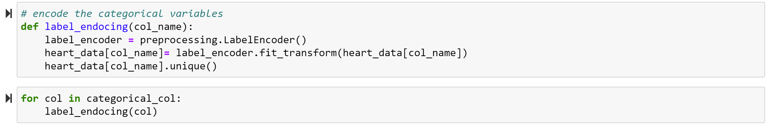
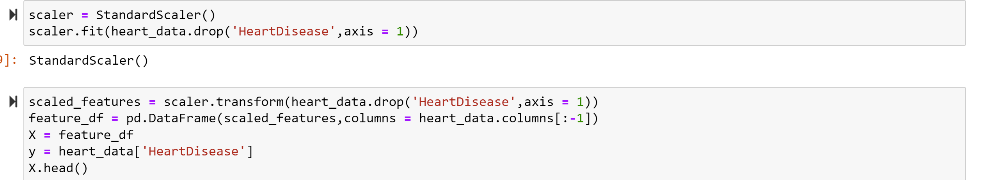
Data Preprocessing & Feature Scaling

Slide 4
Comparison of KNN and Random Forest
Both:
Easy to implement
Suitable for classification task
Advantage of Random Forest over Knn:
More efficiently predict outcomes with large datasets
KNN could perform significantly slower as features or predictor variables increase

Slide 5
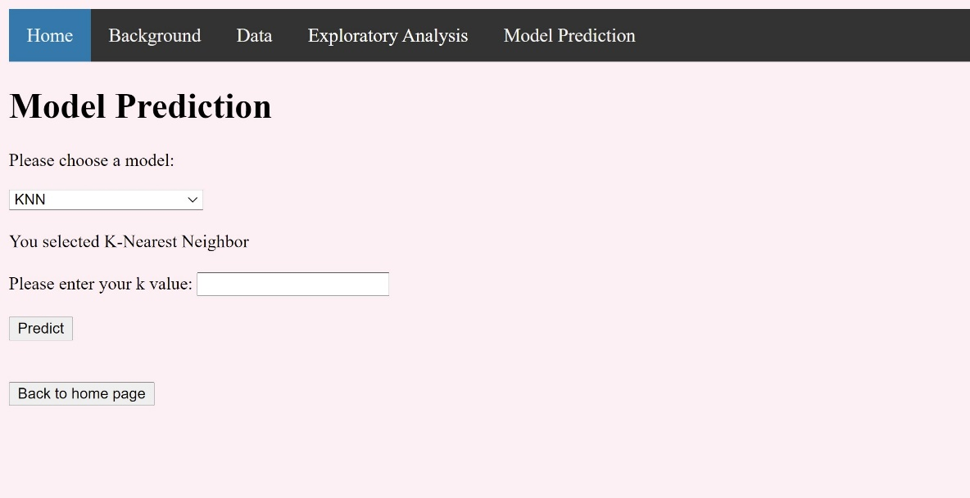
Try it Now!

Slide 6
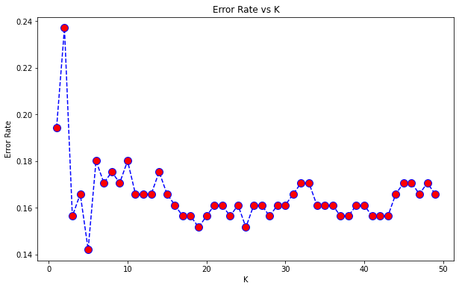
Choosing a K value
k = 5 had the lowest error rate of 14.22%

Slide 7
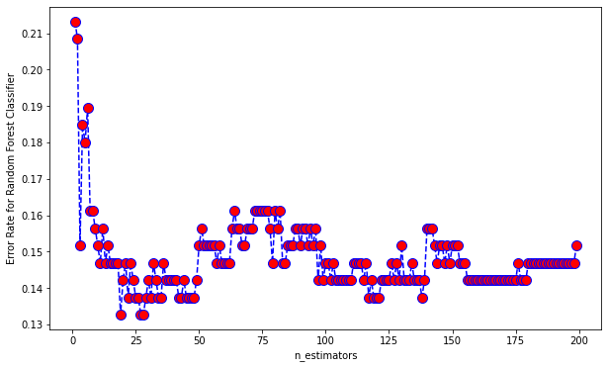
Choosing an n estimator
n=19, 27 and 28 had the lowest error rates with 13.27%

Slide 8
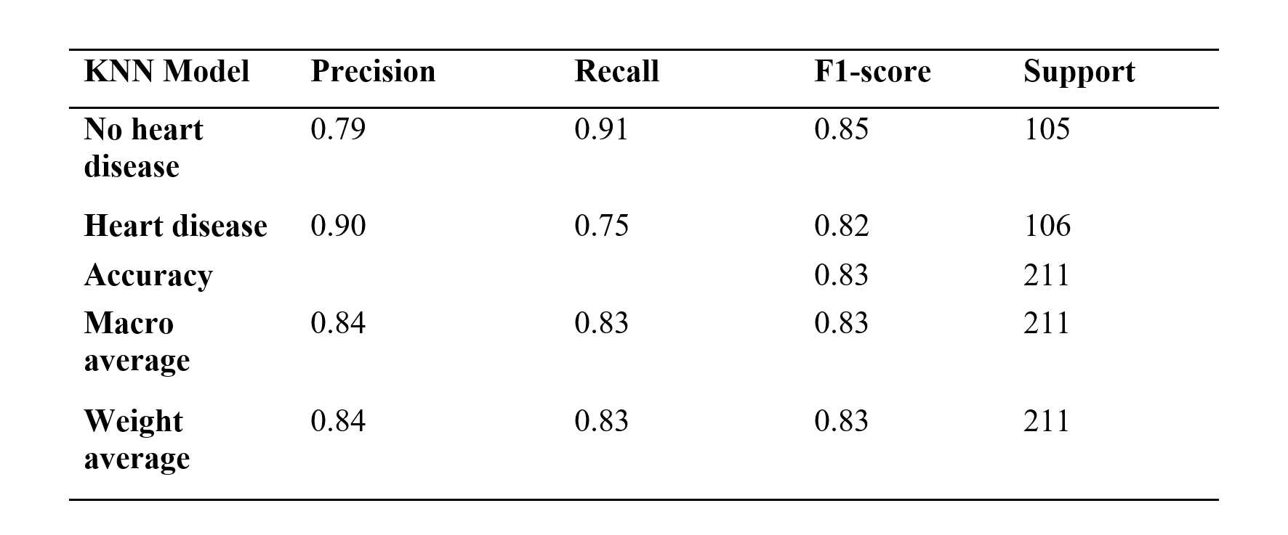
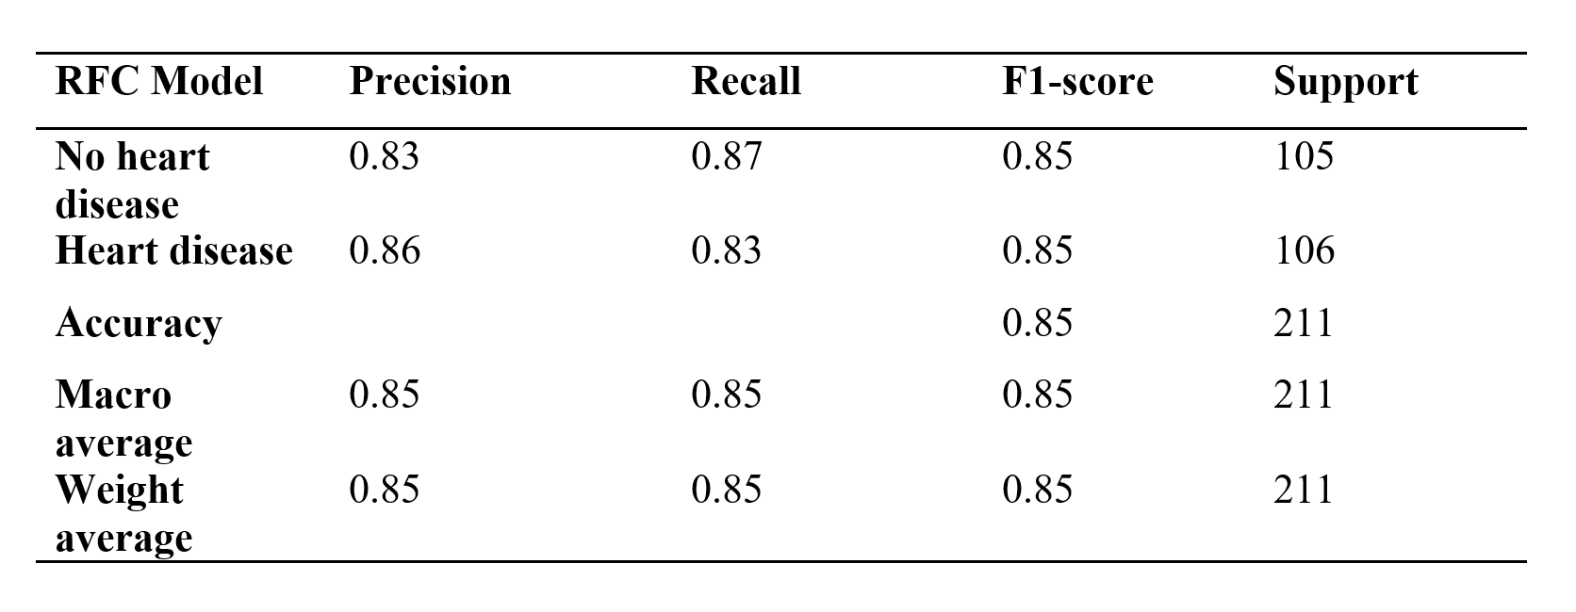
Performance

Slide 9
Findings and Limitations
Findings
50-65 has higher probability of getting heart disease.
Two combined factors out of high blood pressure, high cholesterol, and high blood sugar have greater chances of having heart disease. Each factor alone has no dominating risk for heart disease.
Both models are not ideal for predicting heart disease. However, Random Forest Estimators have better and more stable performance than KNN model using the given dataset.
Limitations
Hard to interpret the measurement of features in the dataset. Not clear if “Cholesterol” in the dataset means total or low-density lipoprotein (LDL).
Too many outliers (e.g., Cholesterol). Removing the outliers can shrink the data.
Probably not enough training data for the machine learning models.

Slide 10
Questions?

Slide 11
Thank you!

